Slide 1
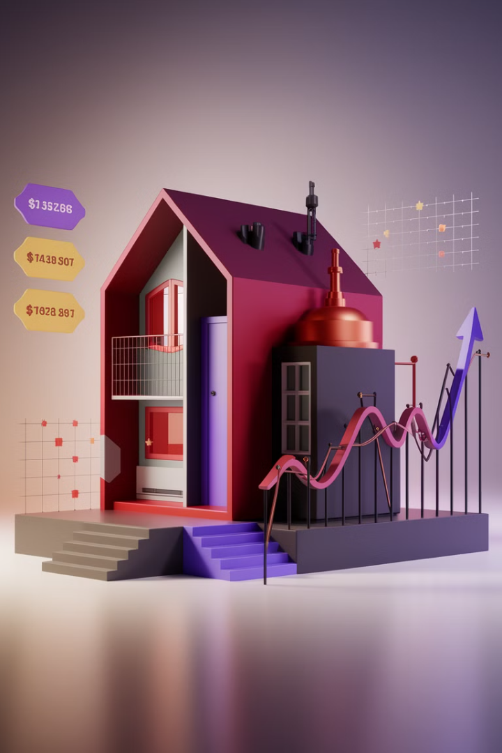
Predicting Tomorrow's Home: The Future of House Prices
Shristi Harish Nayak
Sai Anish Nemalikanti
Rohith Mahakala
Notes:
Good afternoon today me Shristi and my friends anish , rohith are here to give an overview of your project on predicting house future prices.

Slide 2
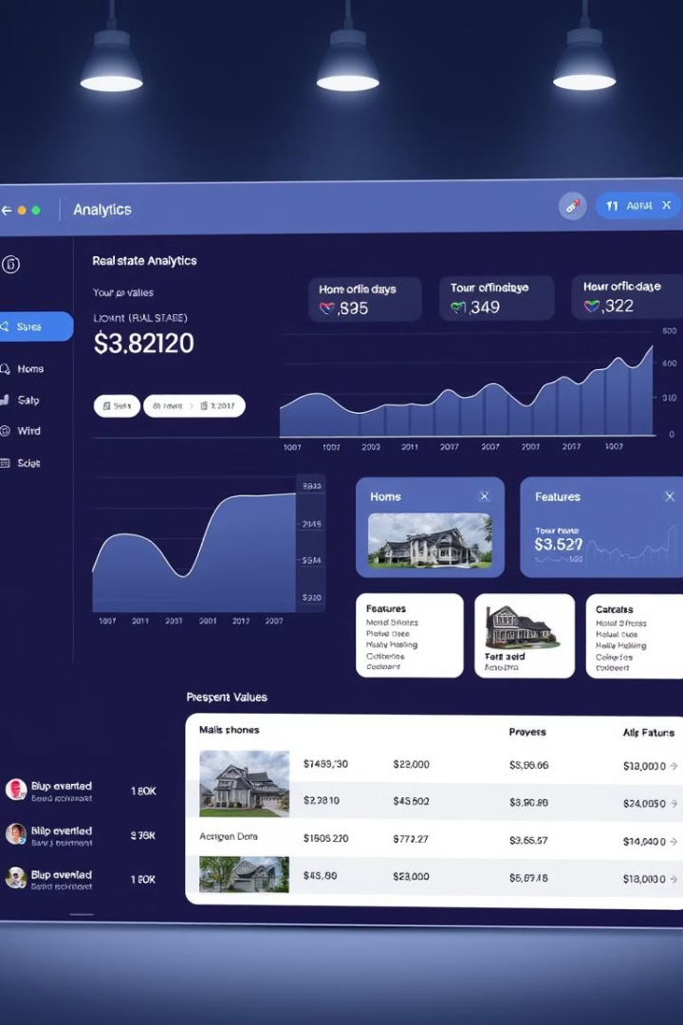
Understanding Real Estate Valuation Through Data Analytics
Real estate valuation is critical for buyers making investment decisions, sellers determining competitive pricing, and investors tracking market trends. It directly impacts financial planning and urban development strategies.
Traditional valuation methods have significant limitations, including over-reliance on basic metrics like square footage and bedroom count, while ignoring nuanced factors such as neighborhood quality, material condition, and zoning laws.
Our project objective is to use regression models to analyze 79+ housing features and identify key drivers of sale prices. For example, a house in a prime location with outdated interiors may still command a high price—traditional models might miss this nuance.
Notes:
Real estate valuation helps buyers, sellers, and investors.
It plays a key role in financial planning and shaping urban development strategies.
Traditional methods focus too much on size and bedroom count, missing important factors like neighborhood quality and building materials.
This can lead to inaccurate valuations
Our project uses regression models to analyze over 79 housing features and find the most important factors influencing sale prices.
For example, a house in a great location but with outdated interiors may still sell at a high price—traditional methods might not capture this.

Slide 3
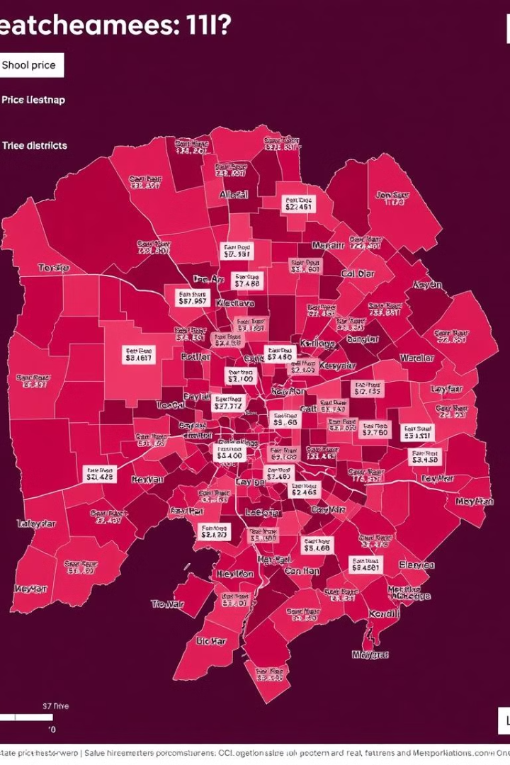
Why Investigate Housing Feature Impacts?
1
Research Question
"Which housing features (structural, location-based, or quality-related) most significantly influence sale prices, and how do regression models compare in predictive accuracy?"
2
Market Relevance
Current tools (e.g., Zillow's Zestimate) often undervalue location and quality.
3
Societal Impact
Empowering stakeholders with data-driven insights for fairer pricing.
Why Focus on Amenities-Based Features? Focusing on house amenities enhances property value, attracts buyers, and improves quality of life, making homes more desirable and competitive in the market.
Notes:
We aim to find which housing features—structure, location, or quality—affect sale prices the most
Many pricing tools, often fail to properly consider location and home quality.
This project helps buyers, sellers, and investors make fairer, data-driven pricing decisions.
Why are focus is on amenities:- Amenities increase property value, attract buyers, and improve overall living standards.

Slide 4





Why This Project Was Done in Data Analytics?
Understanding Housing Market Trends
Feature Selection & Impact Analysis
Predictive Modeling for Price Estimation
Identifies patterns & trends in house prices based on key features (e.g., Lot Size, Year Built).
Determines which factors (Overall Quality, GrLivArea) influence pricing the most.
Uses Ridge, Lasso, and OLS Regression to predict house prices.
Provides a data-driven valuation instead of subjective pricing.
Removes irrelevant features to enhance model accuracy.
Optimizing Decision-Making
Improving Model Accuracy with Data Techniques
Helps buyers, sellers, and investors make informed real estate decisions.
Data cleaning (handling missing values, outliers,one hot encoding, label encoding and StandardScalar) ensures better predictions.
Supports agencies in pricing strategies & risk assessment.
Conclusion: This project leverages data analytics to provide accurate, data-driven house price predictions, improving efficiency & decision-making.
Notes:
We analyze housing trends to see how different factors affect prices.
Feature selection helps us find the most important factors
Data-driven pricing removes guesswork
Cleaning data by handling missing values, outliers and Irrelevant features are removed to improves prediction quality.
Buyers, sellers, and investors can use these insights to make better real estate decisions.
This project leverages data analytics to provide accurate, data-driven house price predictions

Slide 5




The Ames Dataset: A Comprehensive Resource for Housing Analysis
Dataset Source
1
Curated by Dean De Cock (2011)
Modern Alternative
2
Replaces the Boston Housing dataset
Comprehensive Scope
3
2,930 properties in Ames, Iowa
Feature Rich
4
79 explanatory variables with Sale Price as target

Slide 6
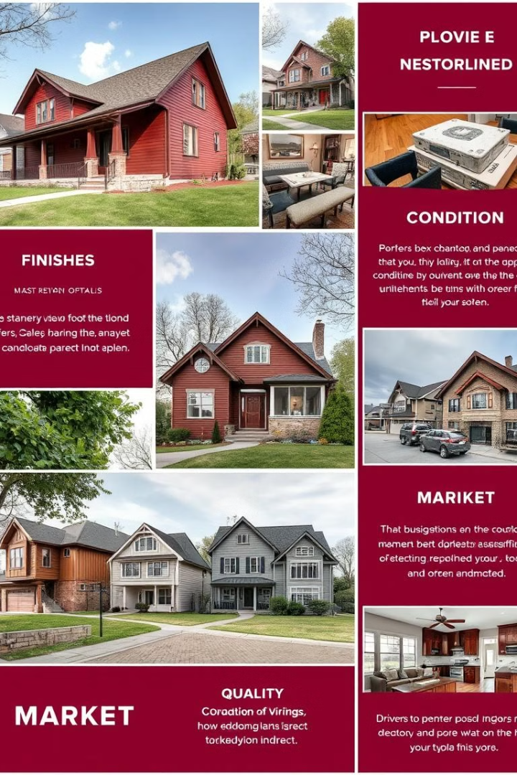
Key Feature
Structural Features
Total rooms, basement size, garage capacity.
Location Factors
Neighborhood (e.g., "Stone Brook" vs. "Old Town"), proximity to parks/highways.
Quality Metrics
Ratings for materials, finishes, and overall condition (e.g., "Excellent" or "Poor").
Market Factors
Sale type (e.g., foreclosure, new sale), zoning classification.

Slide 7

Data Cleaning & Preprocessing
Handling Missing Values
Dropped columns with excessive missing values.
Imputed missing numerical values using mean/mode.
Categorical values were filled with "Unknown" where necessary.
Outlier Detection & Removal
Used Z-score method (removed rows where |Z-score| > 3).
Feature Engineering
Converted categorical variables: Nominal - 37 , Ordinal - 9
Scaling: Scaled numerical features using StandardScaler.
Train-Test Split
divided data into 80% training & 20% testing sets.
Notes:
Nominal features were encoded using one hot encoding and ordinal were encoded using numerical encoding.
z score threshold : 99.7% falls within 3 standard deviations.

Slide 8
Data Cleaning & Preprocessing
Dropped Columns
Mean Imputation
Mode Imputation
PoolQC (1453 missing)
LotFrontage (259 missing)
Electrical (1 missing)
MiscFeature (1406 missing)
Alley (1369 missing)
Fence (1179 missing)
MasVnrType (872 missing)
FireplaceQu (690 missing)
Why It Matters? Ensures missing values don’t bias the model. Keeps relevant features while maintaining accuracy. Improves data consistency for better predictions.

Slide 9
Feature Engineering Formulas
Total Area
House Age
Remodel Indicator
Total Bathrooms
TotalArea = GrLivArea + TotalBsmtSF
HouseAge = YrSold - YearBuilt
Remodel = (YearBuilt ≠ YearRemodAdd)
TotalBathrooms = FullBath + (0.5 × HalfBath) + BsmtFullBath + (0.5 × BsmtHalfBath)
Combines above-ground and basement areas. Represents the total livable space.
Calculates the age of the house at the time of sale.
Binary feature (0 or 1). Indicates if the house was remodeled.
Single feature for all bathrooms. Half-baths have half the weight of full baths.
Notes:
ensures half baths have half the weight

Slide 10
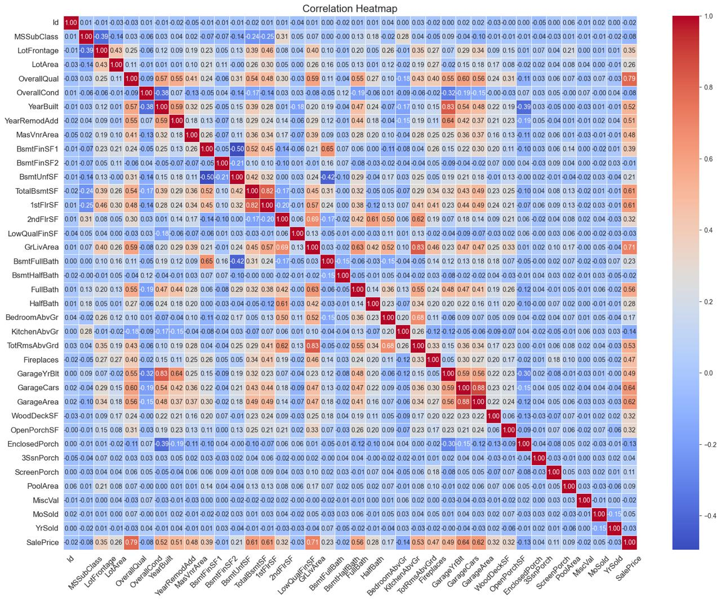
Key Price Drivers: Quality Over Quantity
1
Quality Trumps Everything
2
Renovation Value
Renovated homes and newer constructions tend to sell at higher prices. Year built and year remodeled both show strong positive correlations with price, indicating buyers will pay premium for updated properties.
Our analysis reveals that house price is primarily driven by quality and space rather than land size or extra amenities. The overall quality rating shows the strongest correlation with sale price, confirming that condition matters most to buyers.
3
Luxury Add-ons: Minimal Impact
Interestingly, luxury add-ons like pools and porches have minimal impact on pricing. This challenges the common assumption that expensive amenities automatically translate to higher resale value.
Notes:
high correlation variables: quality and space instead of land size or amenities.
newer houses and renovated houses more price
luxury amenities - pools, porches, have less impact on prices

Slide 11
Key Insights from Feature Correlation Analysis
Strong Price Drivers
Weak Correlations
Non-Linear Relationships
TotalBsmtSF and GrLivArea show strong correlations with SalePrice, confirming that living space and basement size are significant price determinants in the housing market.
LotArea doesn't display a strong pattern with sale prices, indicating that land size alone is not a primary driver of home valuation in this market.
Some feature relationships appear non-linear, suggesting we may need to transform certain variables to improve our predictive model's accuracy.
These findings matter because they help us identify which features deserve more weight in our analysis. Our next step will be to consider dropping or adjusting less significant features like LotArea to reduce noise and improve our model's performance.
Notes:
Why this matters:
Some features are more important than others when determining home prices.
Next step:
We might need to drop or adjust less significant features (like LotArea) to avoid adding noise to our analysis.

Slide 12
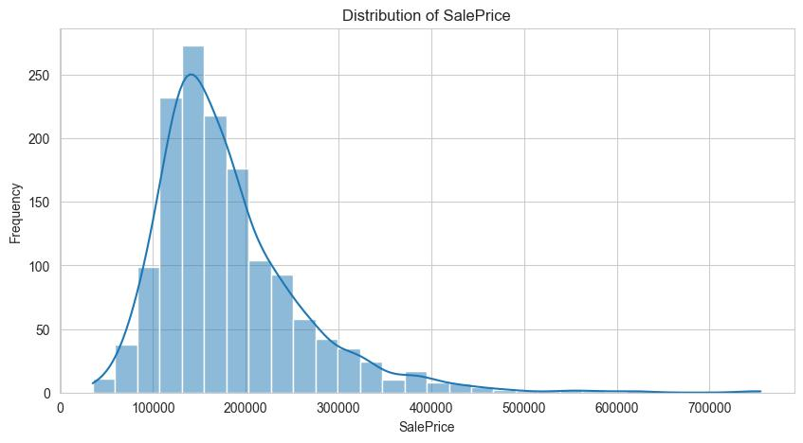
Price Distribution Analysis
The majority of homes in our dataset are priced between $100,000 and $200,000, which is the sweet spot for most buyers. The right-skewed distribution shows that while most houses are affordable, a few luxury homes exceed $500,000, which act as outliers.
The peak around $140,000 indicates the most common price range for homes in Ames. This helps us understand the market trend—most homes are affordable, but we have high-end properties that can skew analysis. We might need to handle outliers carefully to avoid them skewing our conclusions.
Notes:
“Most homes in our dataset fall within the $100,000 - $200,000 range, making it the sweet spot for buyers.”
“The distribution is right-skewed, meaning while most homes are moderately priced, there are a few high-end properties exceeding $500,000.”
“These outliers can impact analysis and should be handled carefully.”

Slide 13
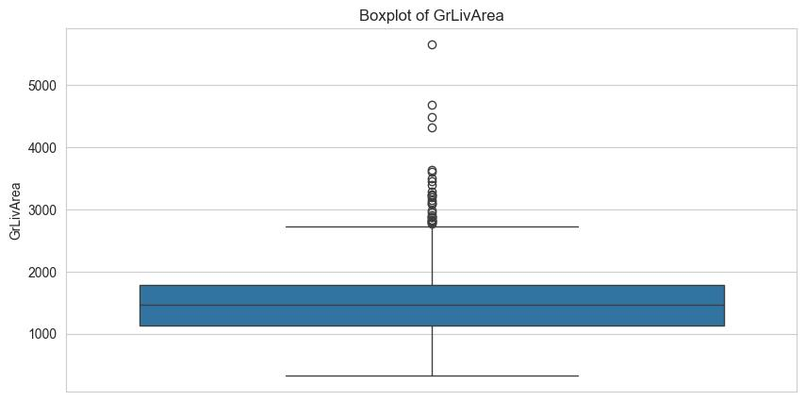
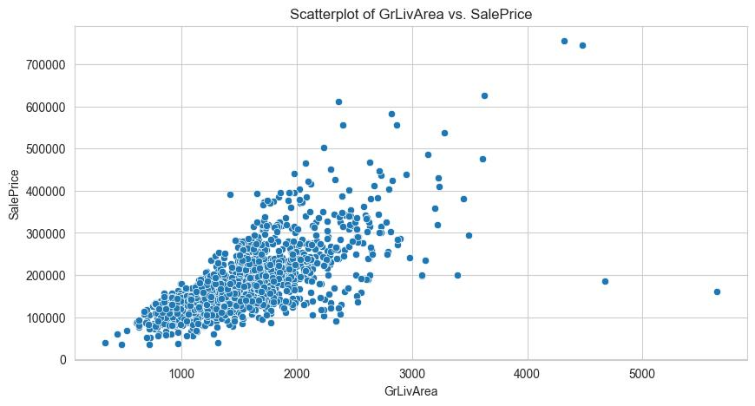
Living Area: Size Matters
Size Distribution
The majority of houses have living spaces between 1,000 to 2,500 sqft. However, some homes are way larger, even above 4,000 sqft these are outliers that might be unique properties or investment homes.
Implications
Buyers pay for space, but size alone doesn't guarantee high prices. This confirms that size matters in home pricing but also raises a red flag about extreme values. Our next step is to investigate why those large homes have outlier status.
Size vs. Price Correlation
The larger the living area, the higher the sale price a clear positive correlation. However, a few very large houses are selling for much lower than expected. This could indicate poor condition, bad location, or market crashes affecting them.
Notes:
The majority of homes have a living area between 1,000 - 2,500 sqft, which is ideal for most buyers.”
“However, some homes are much larger—above 4,000 sqft—these may be luxury properties or investment homes.”
“The clear correlation between larger living areas and higher prices confirms that size plays a major role in valuation.”

Slide 14

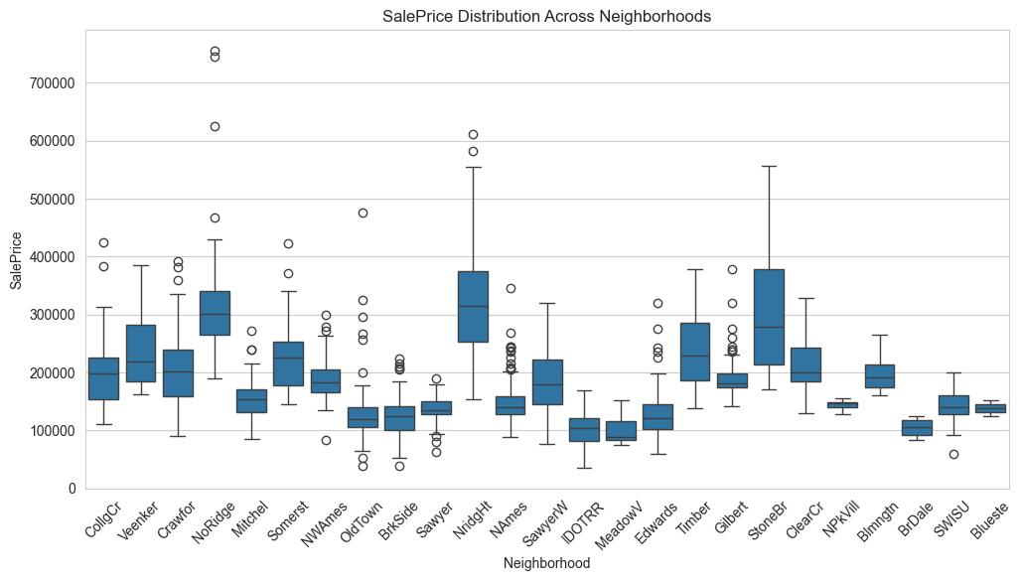
Neighborhood Impact on Pricing
Premium Neighborhoods
Location Premium
Not all neighborhoods are equal. Some, like 'StoneBr', 'NridgHt', and 'NoRidge', have higher median prices, meaning they are more desirable.
Location has a direct impact on pricing some buyers are willing to pay more for better areas.
Notes:
Why this matters:
Location has a direct impact on pricing—some buyers are willing to pay more for better areas.
Next step:
Consider mapping home sales on a geographical plot to visually understand pricing trends by location.
Others neighborhoods, like 'MeadowV' and 'IDOTRR', have significantly lower home prices. These areas may offer better entry points for first-time buyers or investors looking for rental properties with good returns.

Slide 15
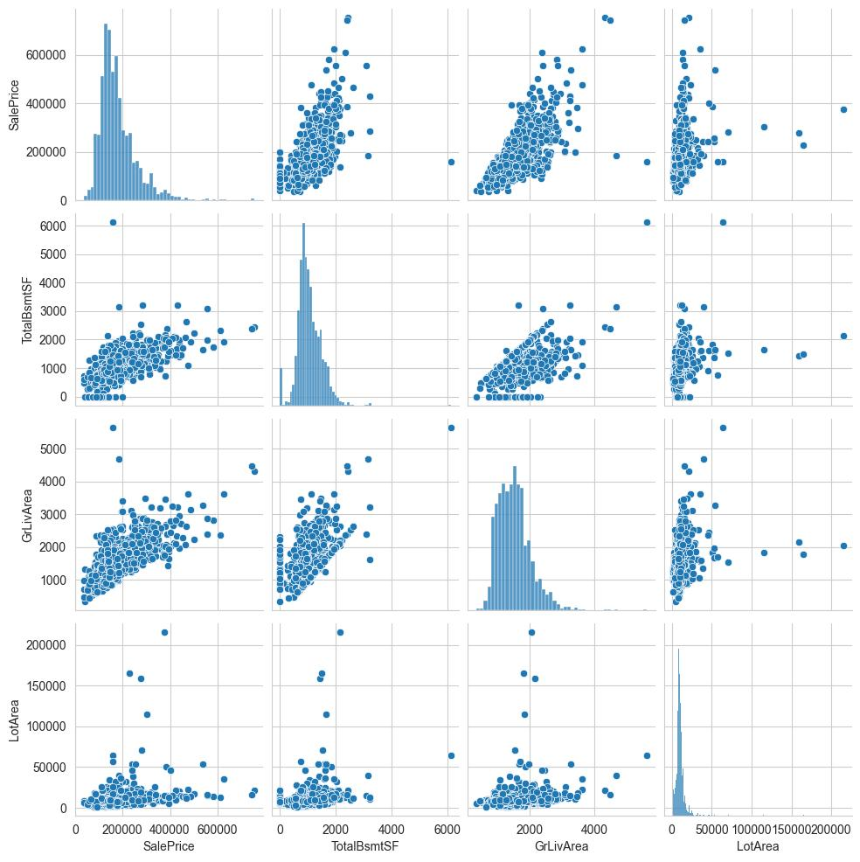
Notes:
We analyzed the relationship between different house features and sale price.”
“The strongest correlations were found with 'OverallQual' (quality), 'GrLivArea' (living space), and 'GarageCars' (garage capacity).”
“Surprisingly, features like 'LotArea' had a weak correlation, meaning lot size is not a major factor in pricing.”

Slide 16
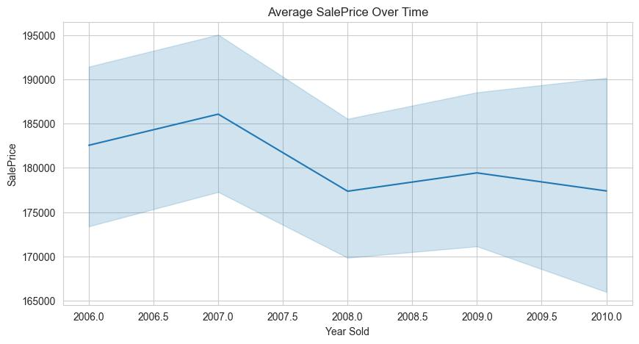
Market Trends Over Time
1
2006-2007: Rising Market
Prices rose steadily during this period, reflecting a strong economy and growing confidence in real estate as an investment. This was the tail end of the housing boom before the financial crisis.
2
2008: Sharp Decline
Prices dropped sharply in 2008—which matches the global financial crisis. This significant downturn affected all segments of the market, though premium properties saw the largest absolute price drops.
3
2009-Present: Recovery
After 2008, prices stabilized, meaning the market recovered after the crash. External economic events (like recessions) directly impact house prices. Understanding these trends helps buyers and sellers make better decisions.
Notes:
We observed key trends in the real estate market over time.”
“From 2006 to 2007, prices were rising steadily.”
“In 2008, there was a sharp decline—this aligns with the global financial crisis.”
“After 2009, prices stabilized, showing a slow recovery in the housing market.”
External economic events (like recessions) directly impact house prices.
Understanding price trends helps buyers & sellers make better decisions.
Next step:
Analyzing seasonality effects—Are there specific months when home sales spike or drop?

Slide 17
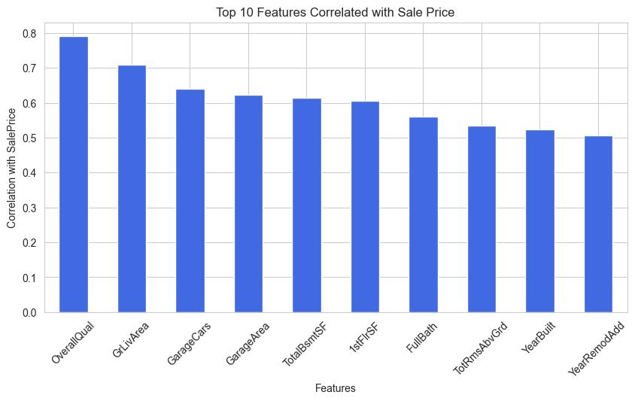
Notes:
We identified the top 10 features most strongly correlated with sale price.”
“'OverallQual' (home quality) was the strongest factor, confirming that buyers prioritize well-built homes.”
“Living space (Ground Living Area, Total basement per SqFeet) and modern renovations (YearRemodAdd) also significantly impact price.”

Slide 18

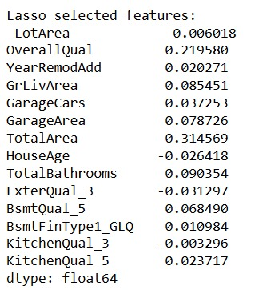
Lasso Regression
Lasso Benefits
Feature Selection
Lasso performs feature selection, identifying key predictors. It sets some coefficients to zero using L1 regularization.
Lasso selected 14 important features.
Cross-validation found an optimal alpha of 0.01.
Model Metrics
Key results include: MSE: 0.1505 and R² Score: 0.8552. The RMSE and MAE were 0.3879 and 0.2759, respectively.
Lasso helps identify most relevant features. Examples are Overallqual, YearRemodAdd, GrLivArea, GarageArea, and TotalArea.
Notes:
Some coefficients become exactly zero

Slide 19
Ridge Regression
Why Ridge?
Key Metrics
Controls multicollinearity.
MSE: 0.0879
Prevents overfitting.
RMSE: 0.2964
Maintains good model performance.
MAE: 0.2024
R² Score: 0.9154
Ridge regression excels by shrinking coefficients using L2 regularization.
Cross-validation optimized alpha to 100.
The strong R² score indicates a good fit.
Notes:
Shrinks but keeps all variables

Slide 20

Ordinary Least Squares (OLS) Regression
1
Why Selected?
2
Results:
Baseline model for comparison.
R² Score: 0.954
Adjusted R-squared: 0.940
F statistic: 66.42
0
Useful for interpretability and understanding variable relationships.

Slide 21



Top Features Correlated with Sale Price
Overall Quality
Living Space
Property Age
Quality beats everything → OverallQual has the strongest correlation with price. This confirms that condition and craftsmanship are the primary drivers of value in residential real estate.
Size matters → GrLivArea, TotalBsmtSF, and GarageCars show strong positive correlation. The total usable space, particularly above-ground living area, significantly impacts a home's market value.
Newer homes sell for more → YearBuilt and YearRemodAdd confirm that modern renovations add value. Buyers prioritize updated properties and are willing to pay premium prices for homes that require less immediate work.
These insights help us understand what truly drives price differences in the housing market. Buyers prioritize quality, space, and garage availability over other factors. Our next step is to use these top features for deeper analysis to develop more accurate pricing models.
Notes:
Why this matters:
Buyers prioritize quality, space, and garage availability over other factors.
Next step:
Use these top features for deeper analysis to understand what truly drives price differences.

Slide 22





Conclusion
Accurate Predictions
Our project successfully used data analytics and regression models to predict house prices with high accuracy.
Quality Matters Most
House condition and renovations significantly impact price. Living space size strongly correlates with higher sale prices.
Location Premium
Certain neighborhoods command higher prices regardless of amenities.
Data-Driven Insights
Buyers can make informed investment decisions. Sellers can strategically price homes based on quality, space, and location.

